Slide 1
Assignment 5 SQL-NoSQL databases
Submitted by: pulkit Mathur

Slide 2
Arango db
Installation
Use link: https://www.arangodb.com/download-major/windows/
Install both client and database for Arnago
Set user name as root and choose a password
Go to http://127.0.0.1:8529/_api/version
Login using root as username and the password you selected.
The default database will be system.
To create a database, open Arango CLI and type command db._createDatabase(database-name)

Slide 3
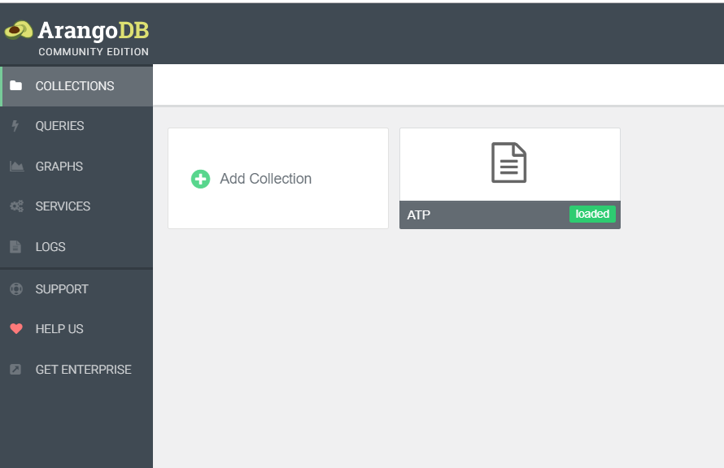
Web view
Here “Collections” refer to the JSON document we will be using.
The database is selected while logging into this web client.
Click on “Add Collection” and upload the JSON file to see records.
The JSON file has 90,000 records.

Slide 4
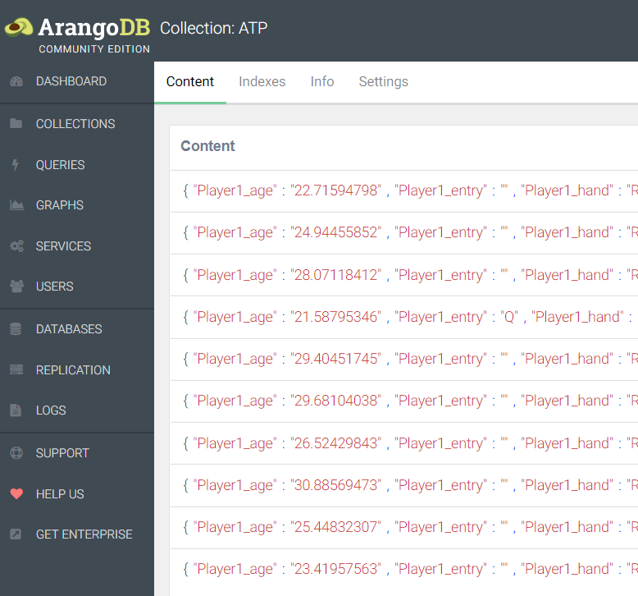
DAta
After importing the JSON file, you can see the data as shown.
To query the data, you need to go to the “query” tab on the left side panel.
These queries are called AQL queries. Each collection is analogous to table in SQL and each row of SQL is analogous to document.

Slide 5
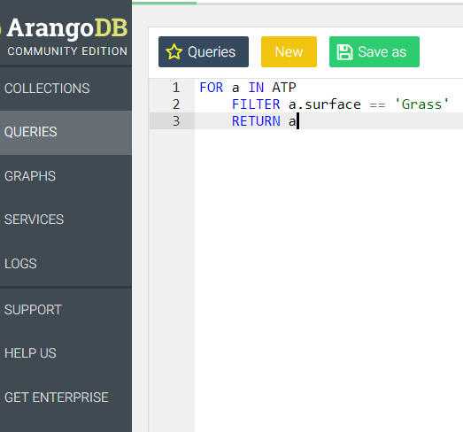
Query 1
Query to select all records where surface is Grass.

Slide 6
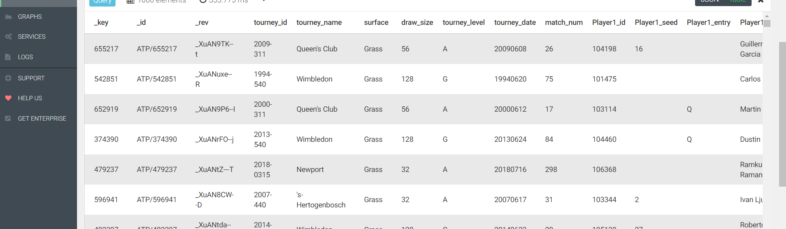
Query 1 result
Query to select all records where surface is Grass.

Slide 7
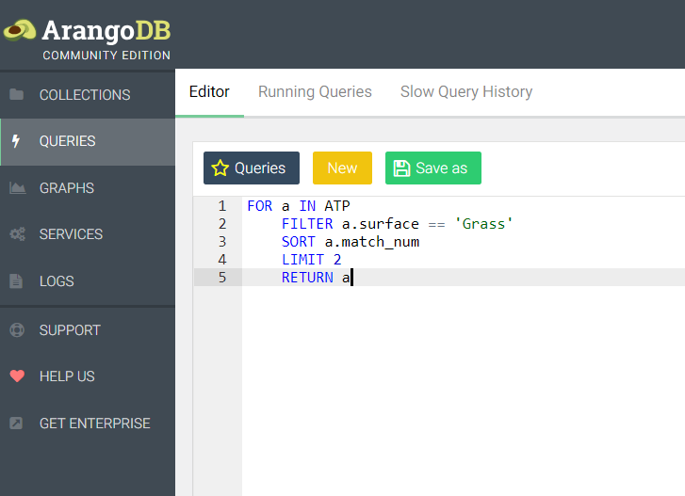
Query 2
Query to select records where surface is Grass and sort the results by match numbers and limit to two records.

Slide 8
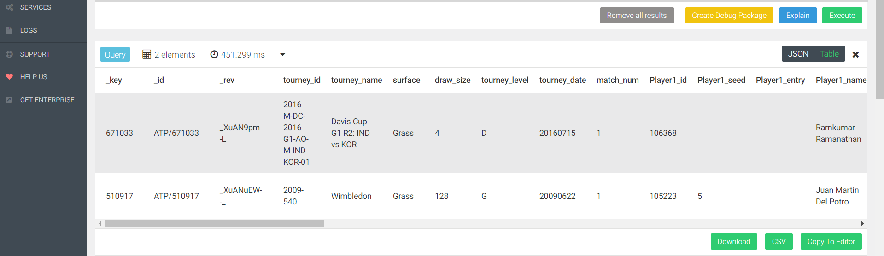
Query 2 result

Slide 9
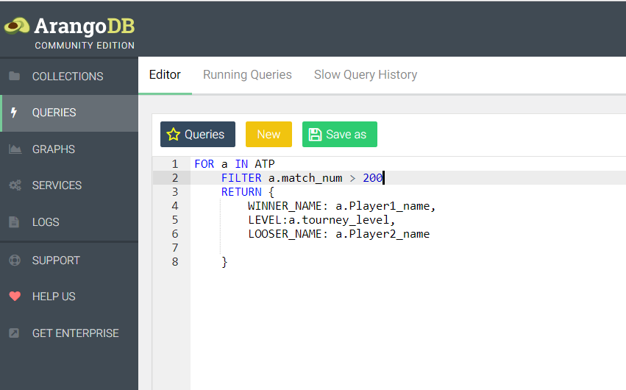
Query 3
Query to filter records where matches are more than 200 and return specific attributes of data with renaming of attributes.

Slide 10
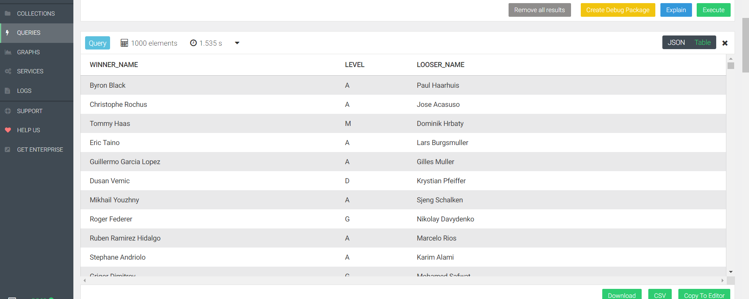
Query 3 result

Slide 11
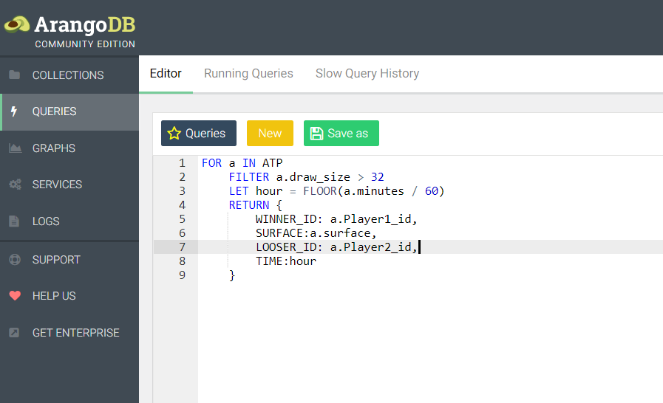
Query 4
Query to filter records by draw size and calculating time using a temporary variable and returning specific features.

Slide 12
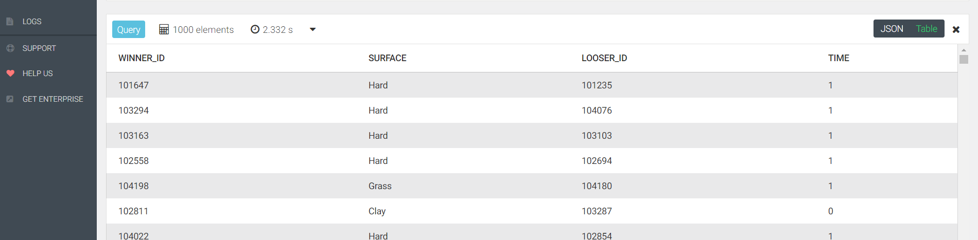
Query 4 result

Slide 13
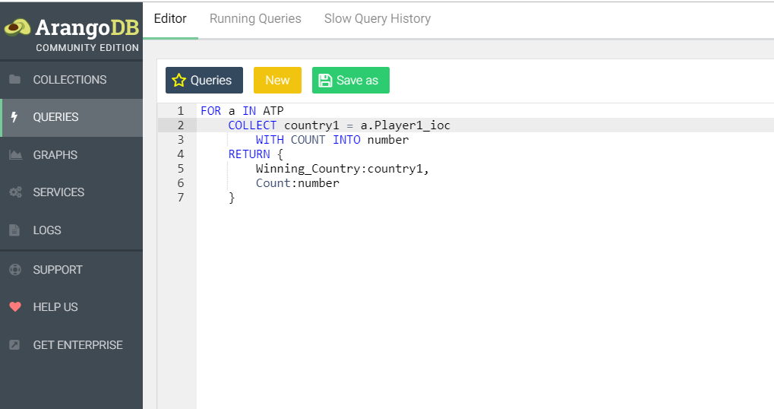
Query 5
Using COLLECT statement to count number of players from each country.

Slide 14
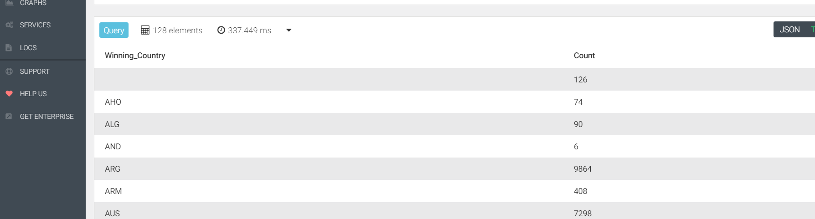
Query 5 result

Slide 15
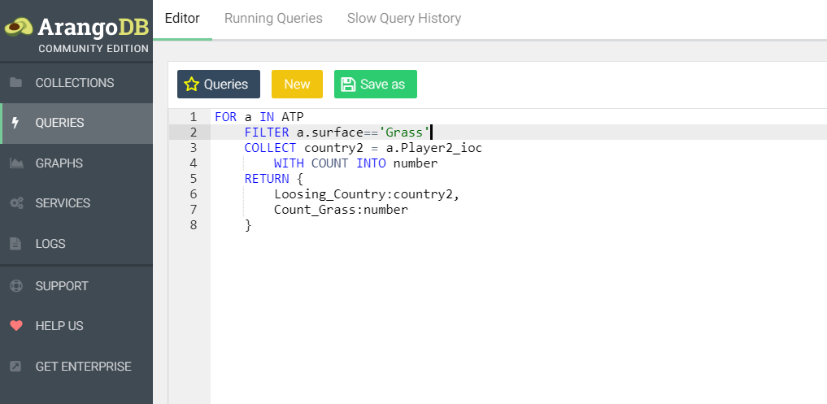
Query 6
Query to filter records based on surface, then finding loosing player from each country and returning the calculated data.

Slide 16
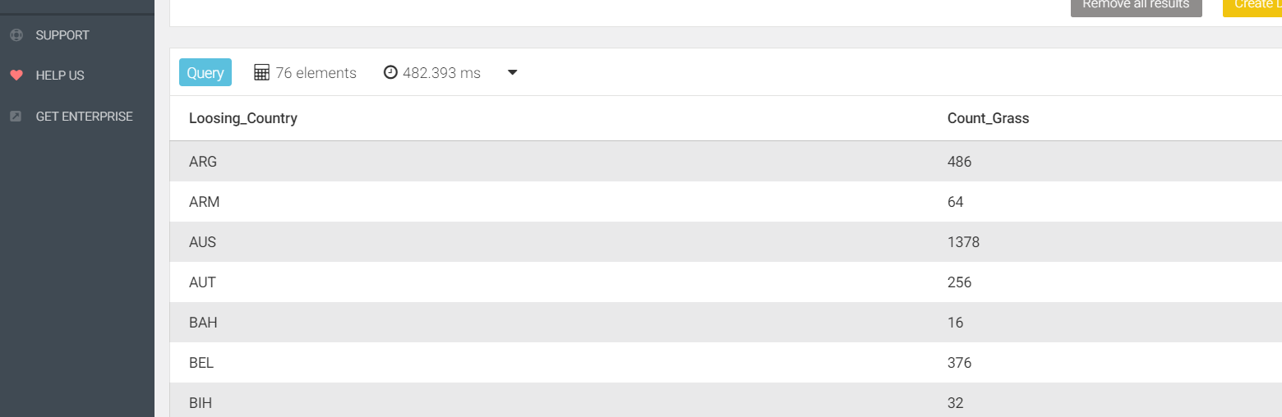
Query 6 result

Slide 17
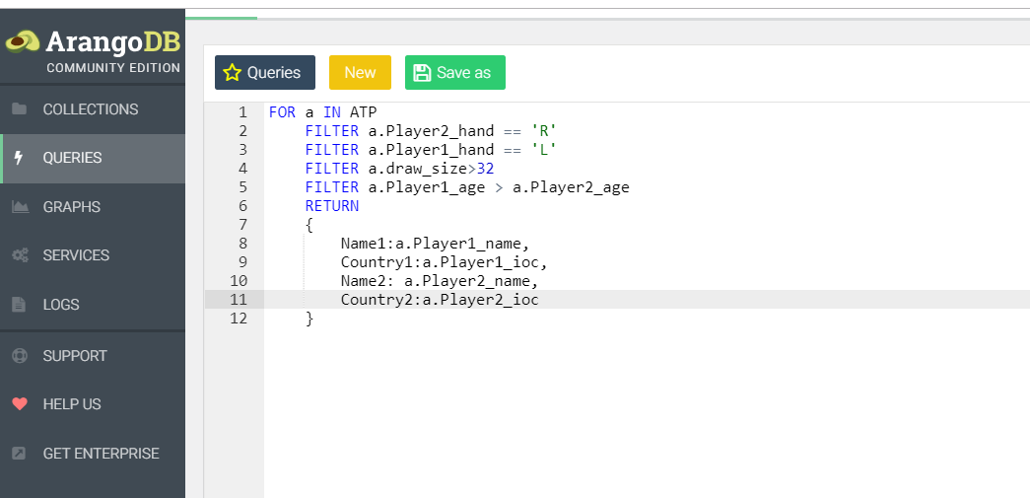
Query 7
Query to show multiple filters usage.

Slide 18
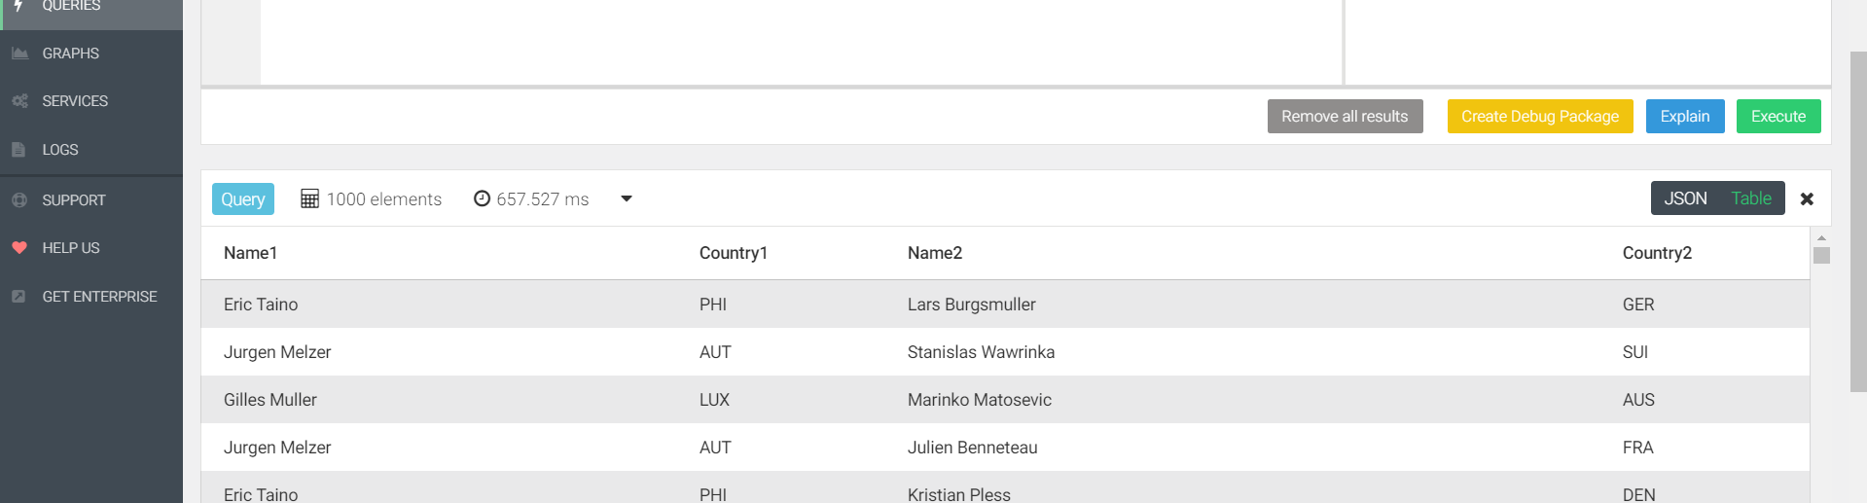
Query 7 result

Slide 19
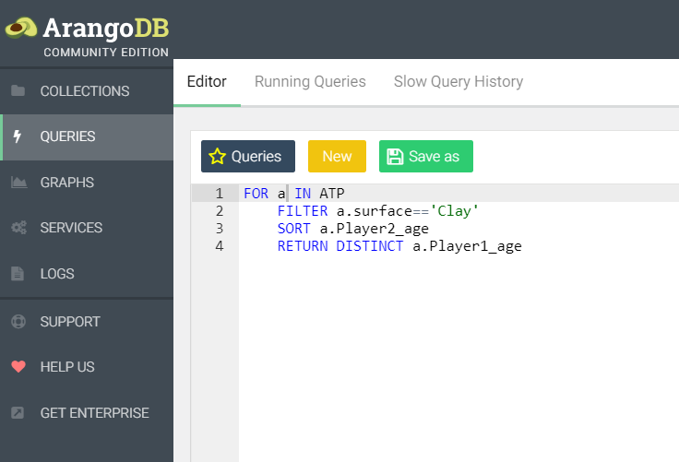
Query 8
Query to demonstrate the use of FILTER, SORT and DISTINCT keywords together.

Slide 20
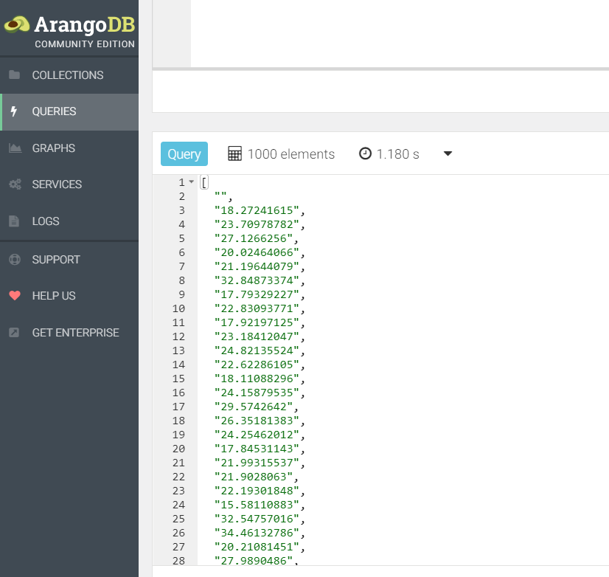
Query 8 result

Slide 21
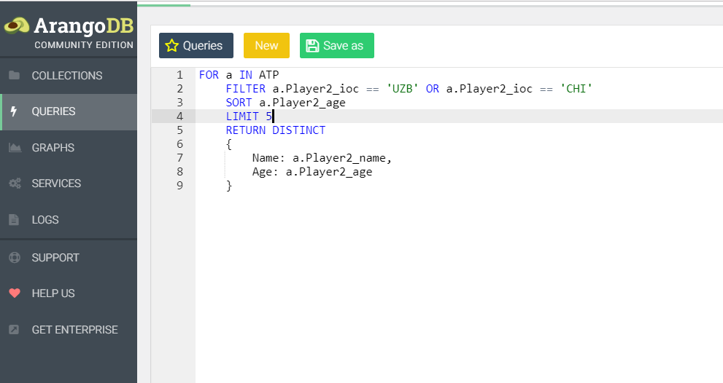
Query 9
Query to demonstrate usage of OR statement and LIMIT with DISTINCT.

Slide 22
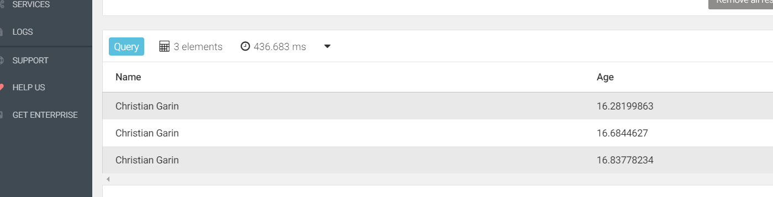
Query 9 result

Slide 23
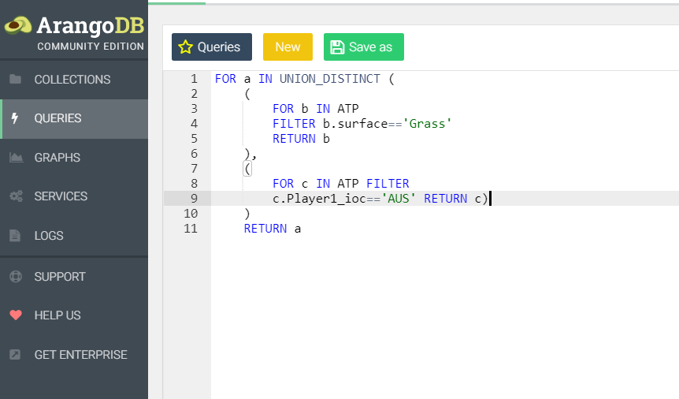
Query 10
Union Distinct query example.

Slide 24
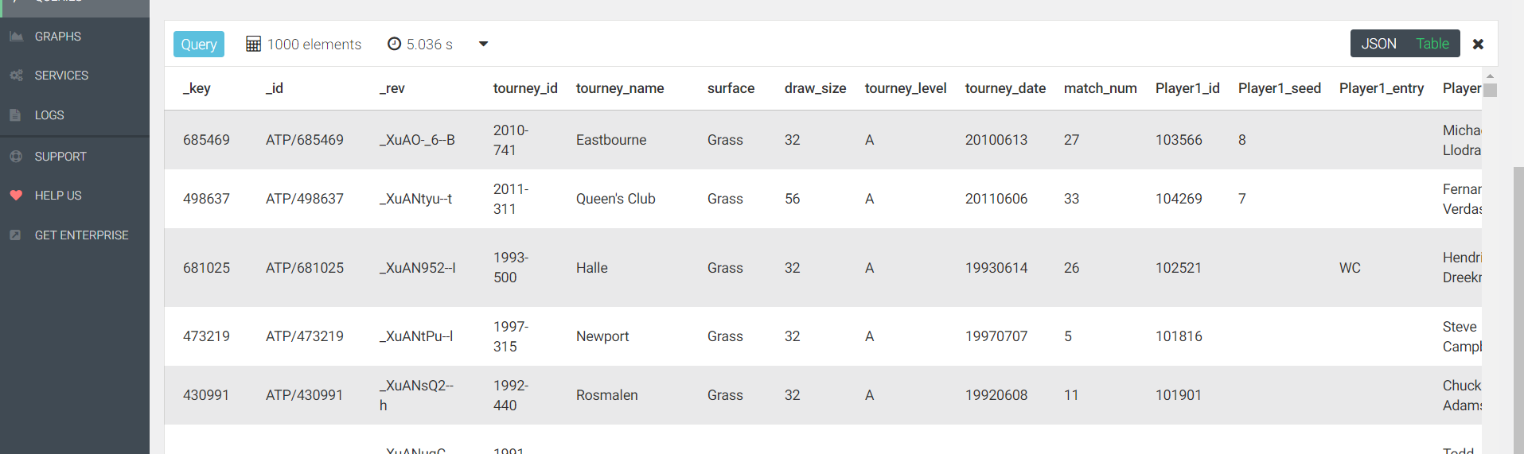
Query 10 result

Slide 25
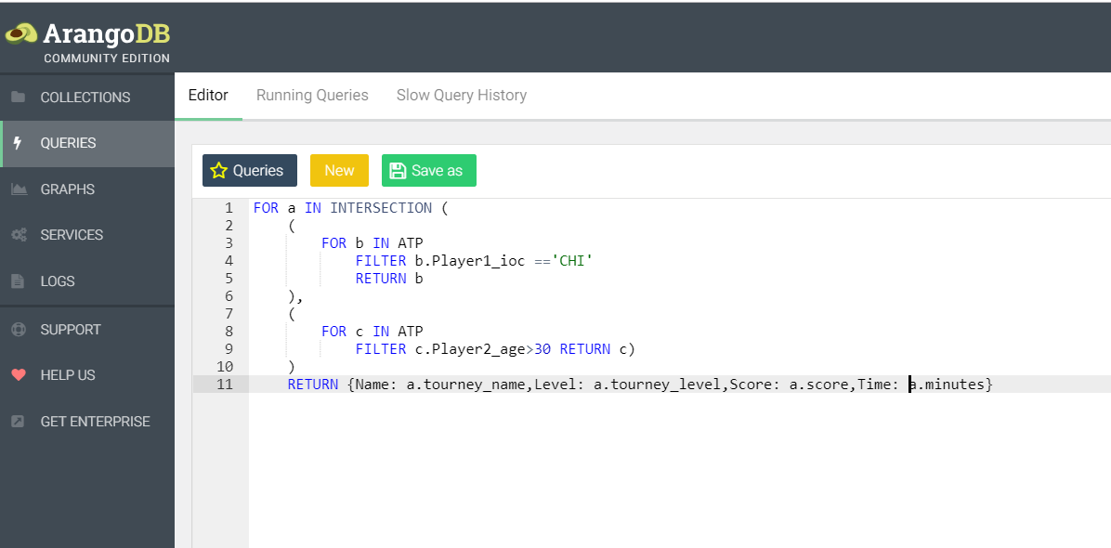
Query 11
Intersection Query

Slide 26
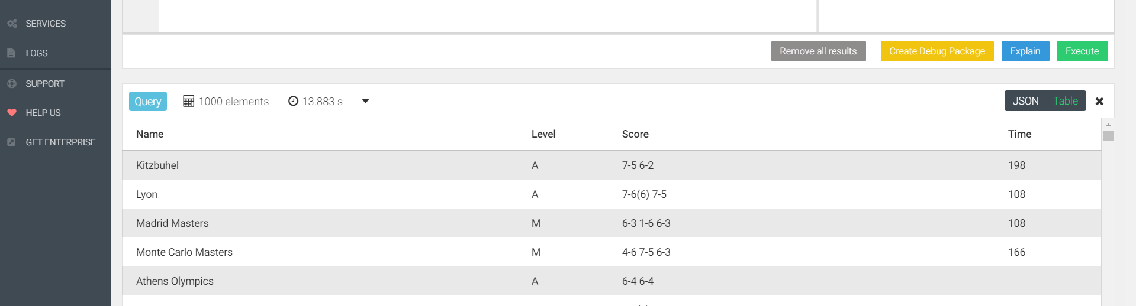
Query 11 result

Slide 27
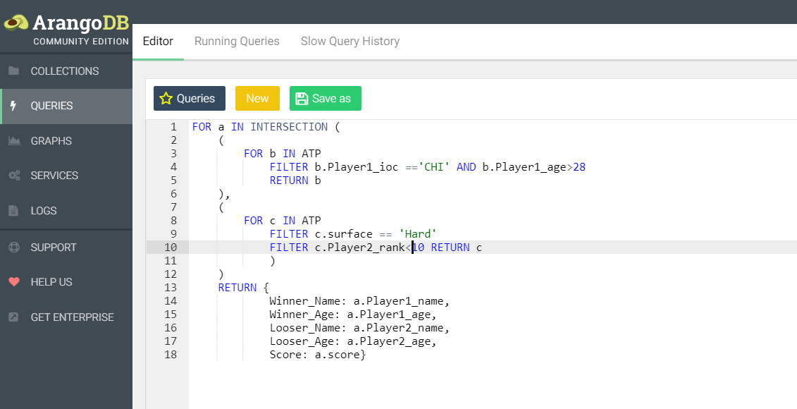
Query 12
Complex Intersection Query

Slide 28
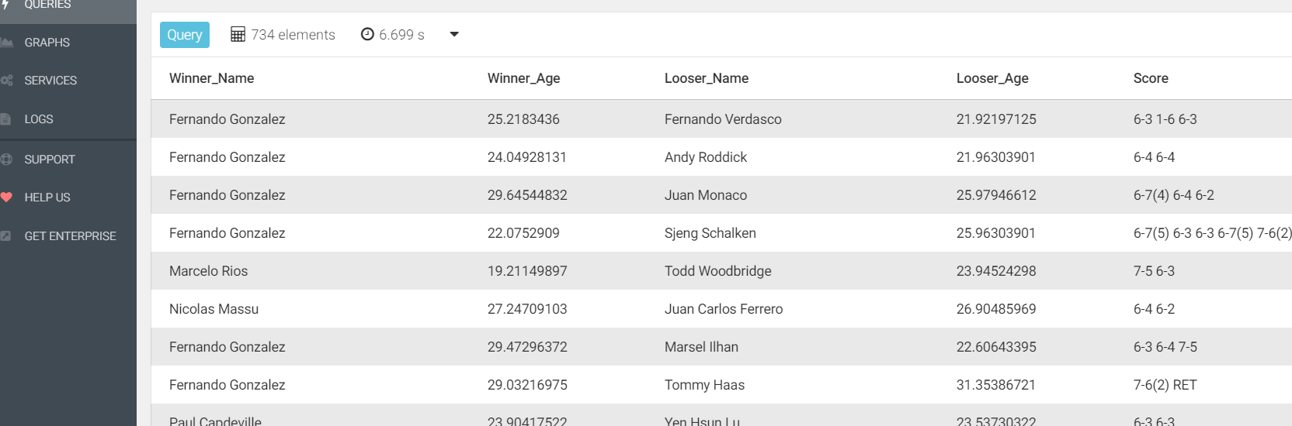
Query 12 result

Slide 29
Data visualization
Tableau was used to perform data visualization and analysis on the data set.
Please find the results in next set of slides

Slide 30
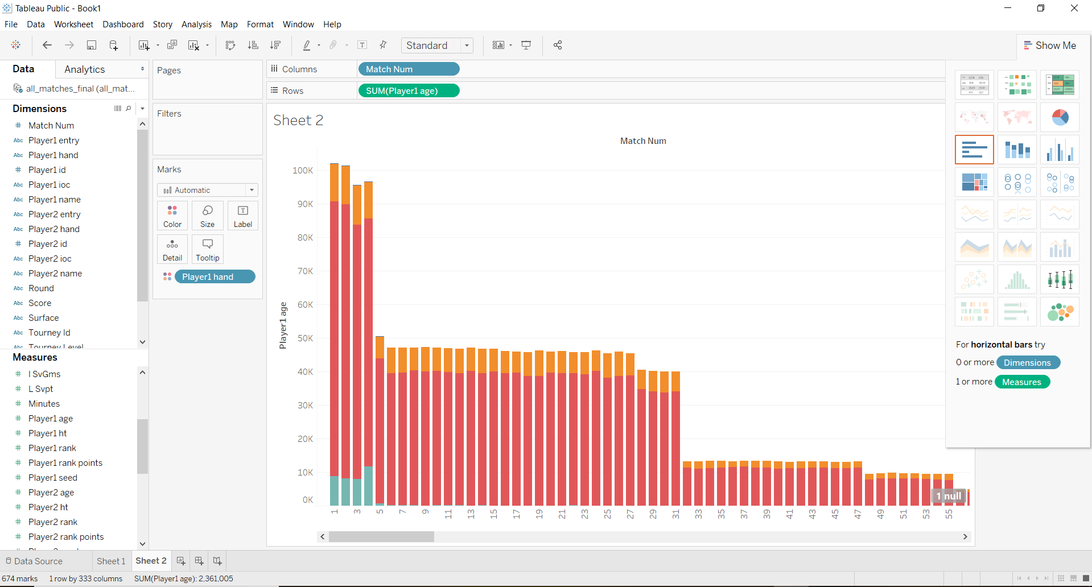
View 1

Slide 31
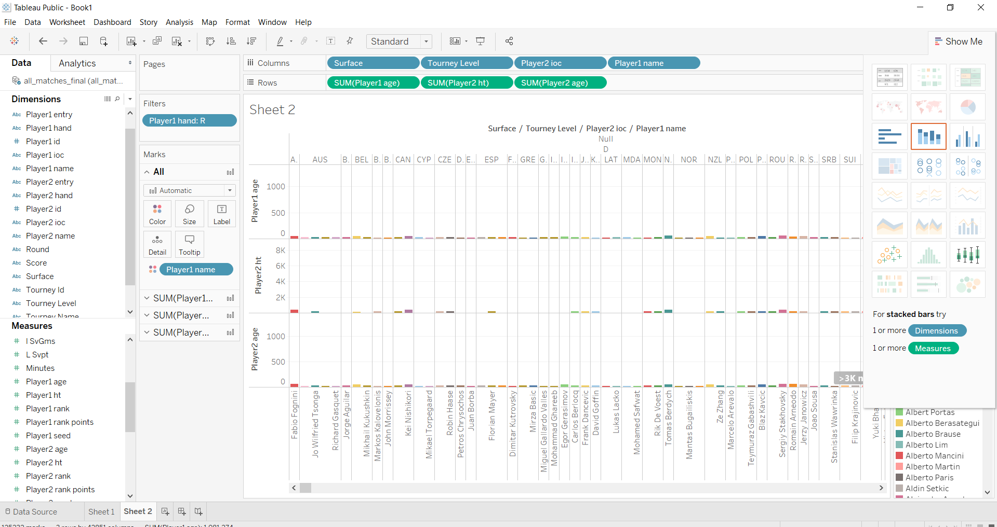
View 2

Slide 32
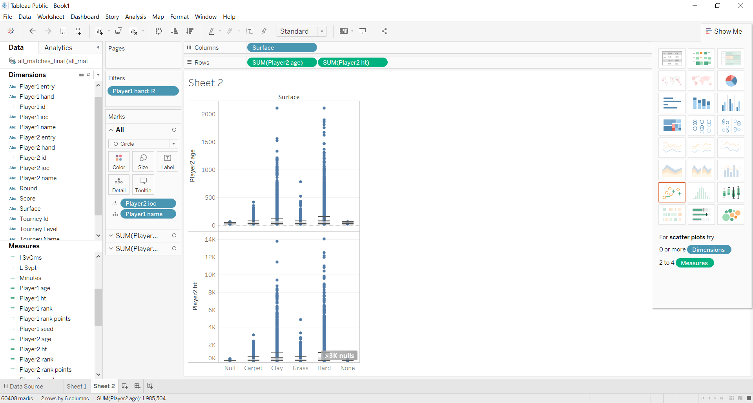
View 3

Slide 33
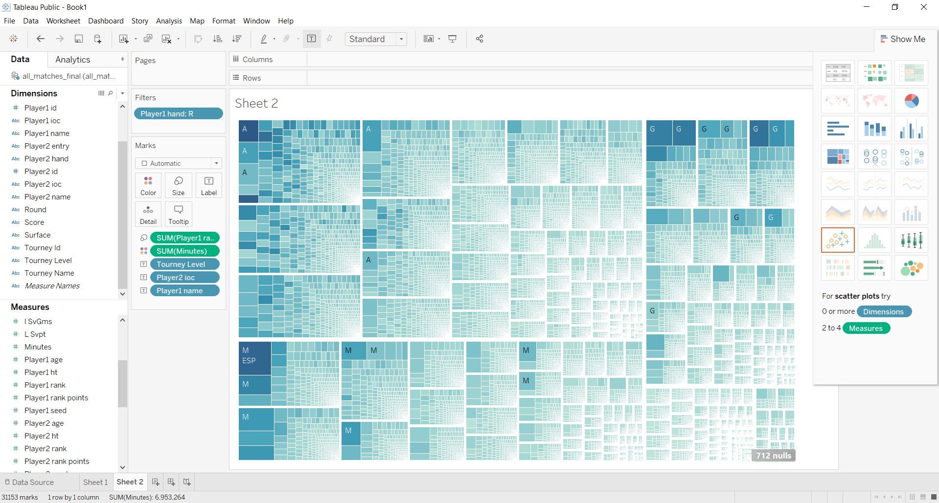
View 4

Slide 34
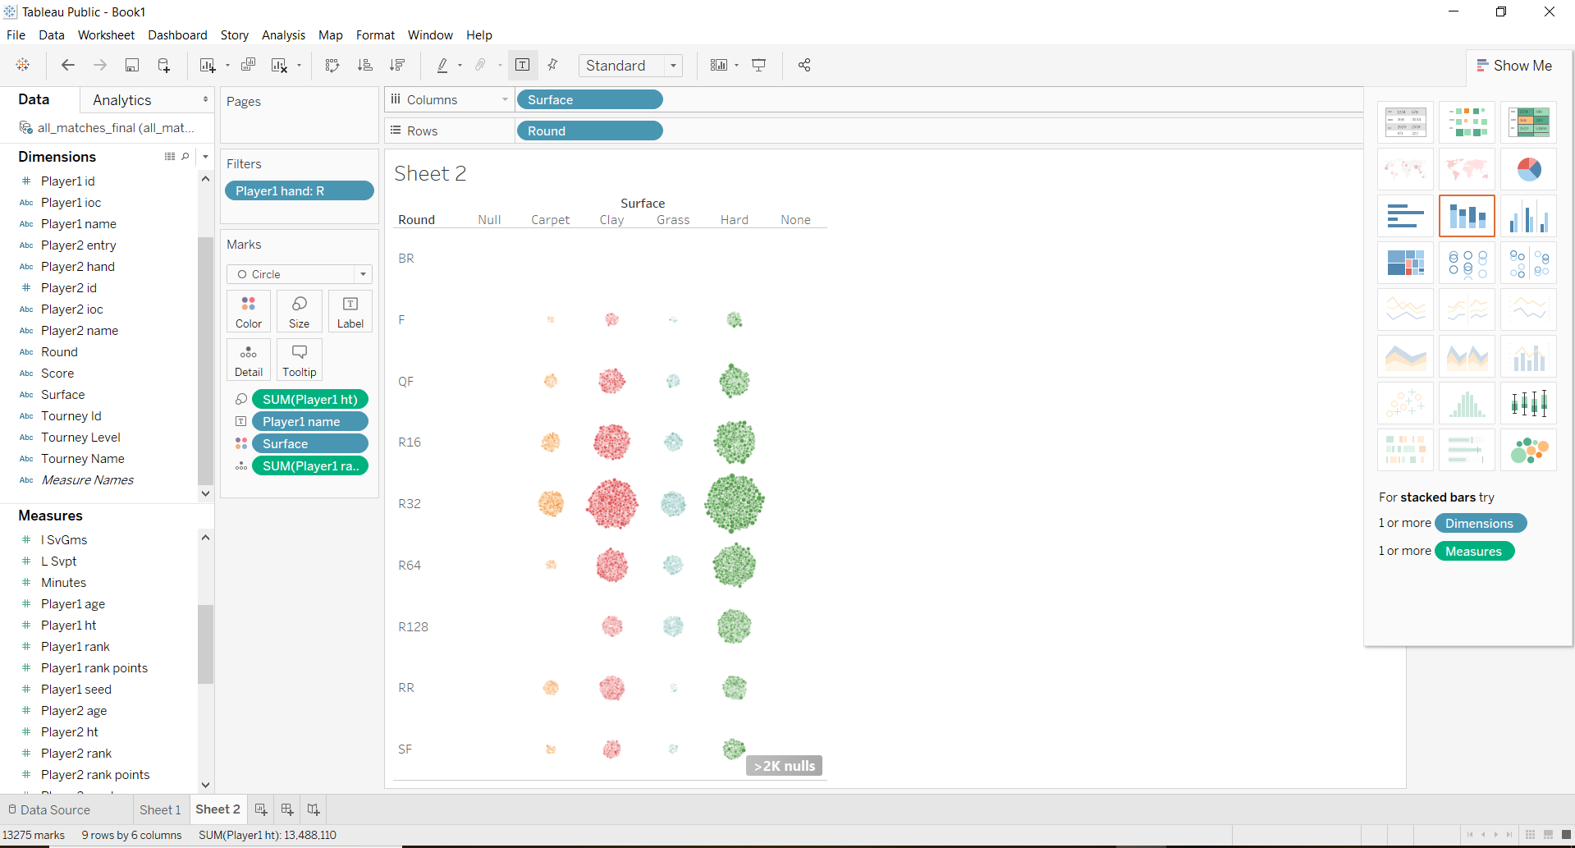
View 5

Slide 35
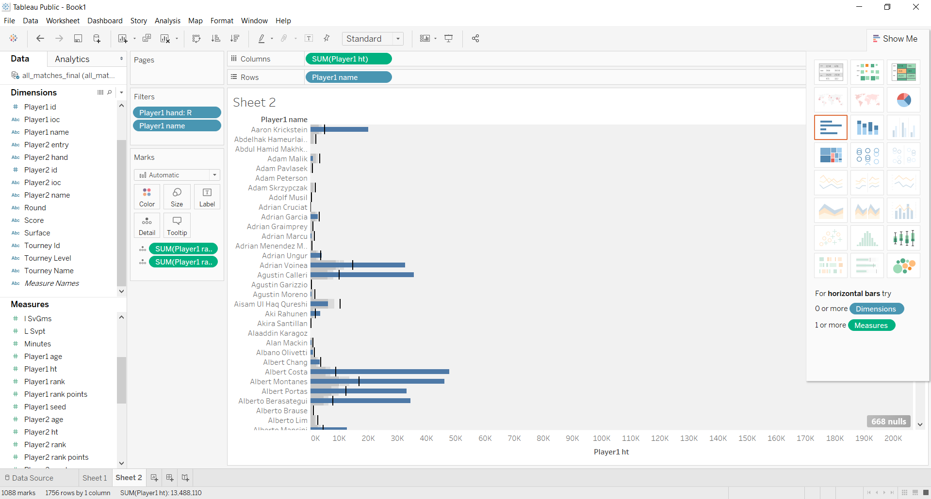
View 6

Slide 36
Data analysis and machine learning to predict winner of tournament
Players Dataset
#Features: 50
#Training Examples: 92020
Data Preprocessing:
Replace missing numerical values with average
Replace missing categorical values with mode
Drop a few features
Convert categorical Data to numeric
Normalize numeric data

Slide 37
Exploratory data analysis
Histogram plots
Sns plots
Both plots for all features

Slide 38
Models developed
Linear Regression
Test Accuracy: 39.45%
Logistic Regression
Test Accuracy: 89.205%
Neural Network
Test Accuracy: 89.605%
Random Forest
Test Accuracy: 81.522%
Therefore, the neural network was the best classifier

